Slide 1
Deep Learning for Instance-level Object Understanding CVPR 2017 Tutorial on Deep Learning for Objects and Scenes
Ross Girshick
in collaboration with
Kaiming He, Georgia Gkioxari, Tsung-Yi Lin (Cornell Tech),
Bharath Hariharan, Piotr Dollár
Facebook AI Research (FAIR)

Slide 2


Slide 3
… Now you’re Experts in Deep Representations
This talk: object detection and instance-level object understanding

Slide 4
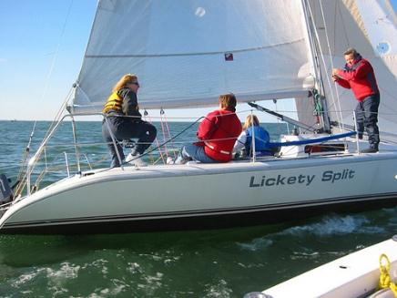
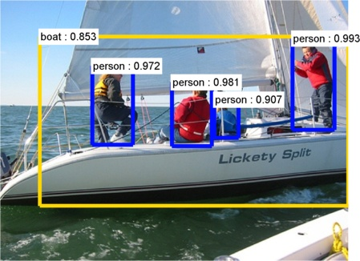
Object Detection
boat
person
Image classification
(what? I don’t care where)
Object detection
(what + where?)

Slide 5
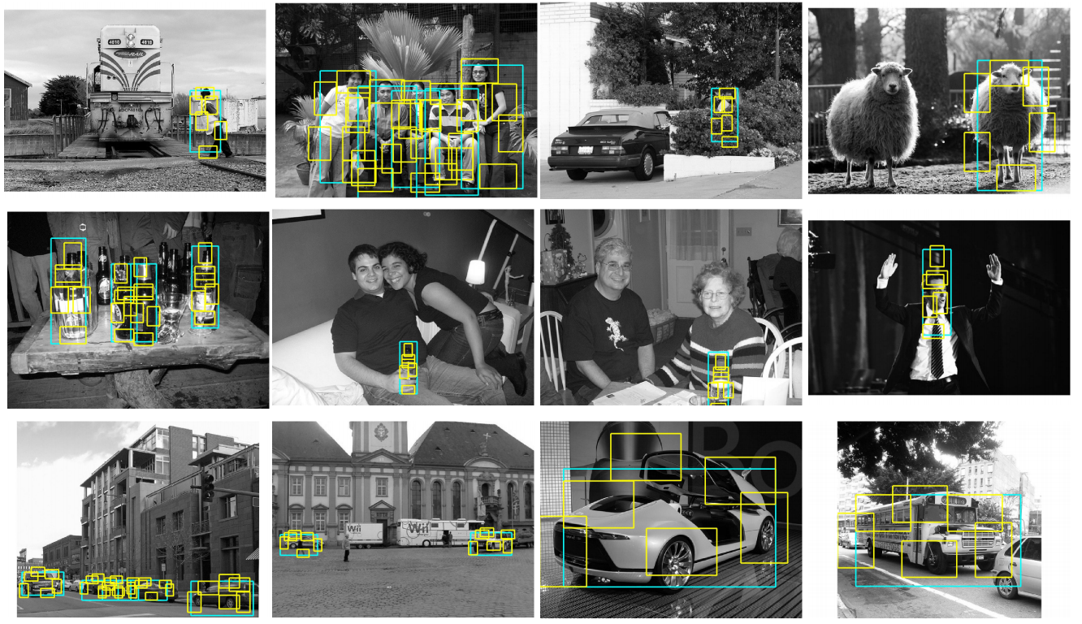
Object Detection circa 2007
Felzenszwalb, Ramanan, McAllester. A Discriminatively Trained, Multiscale, Deformable Part Model. CVPR 2008 (DPM v1)

Slide 6
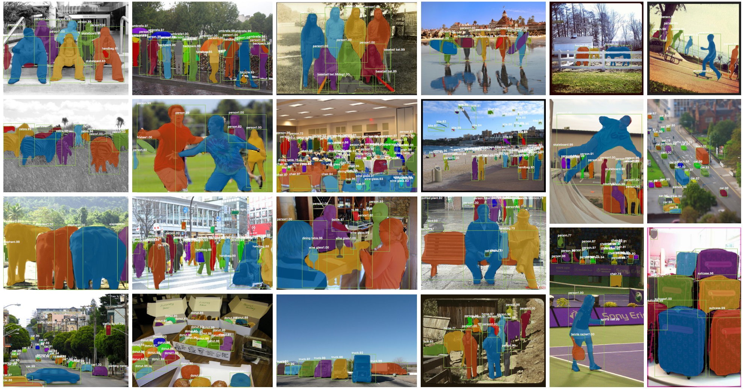
Object Detection Today
He, Gkioxari, Dollár, Girshick. Mask R-CNN. In ICCV 2017

Slide 7
Instance-level Object Understanding Today
He, Gkioxari, Dollár, Girshick. Mask R-CNN. In ICCV 2017

Slide 8
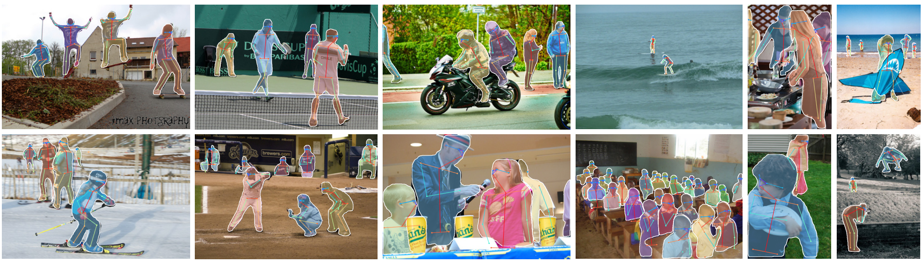
Instance-level Object Understanding Today
He, Gkioxari, Dollár, Girshick. Mask R-CNN. In ICCV 2017

Slide 9
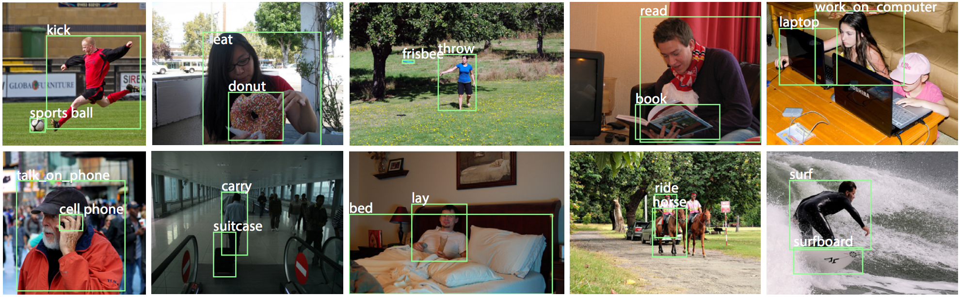
Instance-level Object Understanding Today
Gkioxari, Girshick, Dollár, He. Detecting and Recognizing Human-Object Interactions. arXiv 2017

Slide 10
Outline
Mask R-CNN [25 min]
Task
Model
Training
Inference
Deep Learning Methods for Object Detection [10 min brief survey]
Landscape of methods
Speed/accuracy tradeoffs
How we got here (2007 vs. 2017)
Some open directions in instance-level understanding

Slide 11
Task: Instance Segmentation
Object detection
Semantic segmentation
Instance segmentation
Person 4
Person 4
Person 5
Person 5
Person pixels
Things become stuff
A faceless mass of person pixels
Person 1
Person 1
Person 3
Person 2
Person 2
Person 3
Image from PASCAL VOC

Slide 12
Task: Instance Segmentation
Object detection
Semantic segmentation
Instance segmentation
Person 4
Person 4
Person 5
Person 5
Person pixels
Things become stuff
A faceless mass of person pixels
Person 1
Person 1
Person 3
Person 2
Person 2
Person 3
Image from PASCAL VOC

Slide 13
Task: Instance Segmentation
Object detection
Semantic segmentation
Instance segmentation
Person 4
Person 4
Person 5
Person 5
Person pixels
Things become stuff
A faceless mass of person pixels
Person 1
Person 1
Person 3
Person 2
Person 2
Person 3
Image from PASCAL VOC
Best of both tasks

Slide 14
Mask R-CNN: Model Overview
R-CNN-style detection system
Backbone architecture
Feature Pyramid Network (FPN)
Region Proposal Network (RPN)
Region of interest feature alignment (RoIAlign)
Multi-task network head
Box classifier
Box regressor
Mask predictor
Keypoint predictor
Modular composition of many recent ideas

Slide 15
0. R-CNN-style Approach to Object Detection
RoI transformation
(applied to image or conv features)
Input image
Object / region proposals (RoIs)
(external or internal to network)
Deep Learning-based region classifier
Detection =
Region classification + box regression + …
General formula for
Region-based CNN models
Girshick, Donahue, Darrell, Malik. Rich Feature Hierarchies for Accurate Object Detection and Semantic Segmentation. CVPR 2014
Uijlings, van de Sande, Gevers, Smeulders. Selective Search for Object Recognition. IJCV 2013

Slide 16
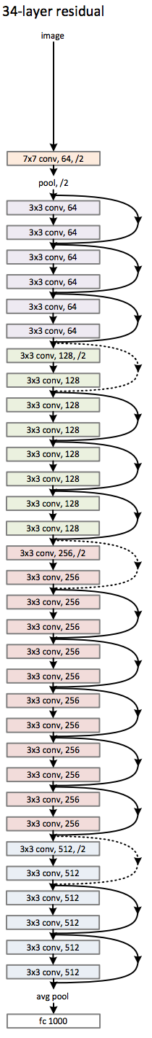
1. Backbone ConvNet
Example:
ResNet-34
Use any standard ConvNet as a “backbone architecture”
AlexNet, VGG, ResNet, Inception, Inception-ResNet, ResNeXt (poster 67 Tuesday morning), …
Use “same” padding everywhere (preserves integer scales)
Prefer fully convolutional networks (ignoring cls head; see next slide)
Pre-train on ImageNet classification (or similar)

Slide 17
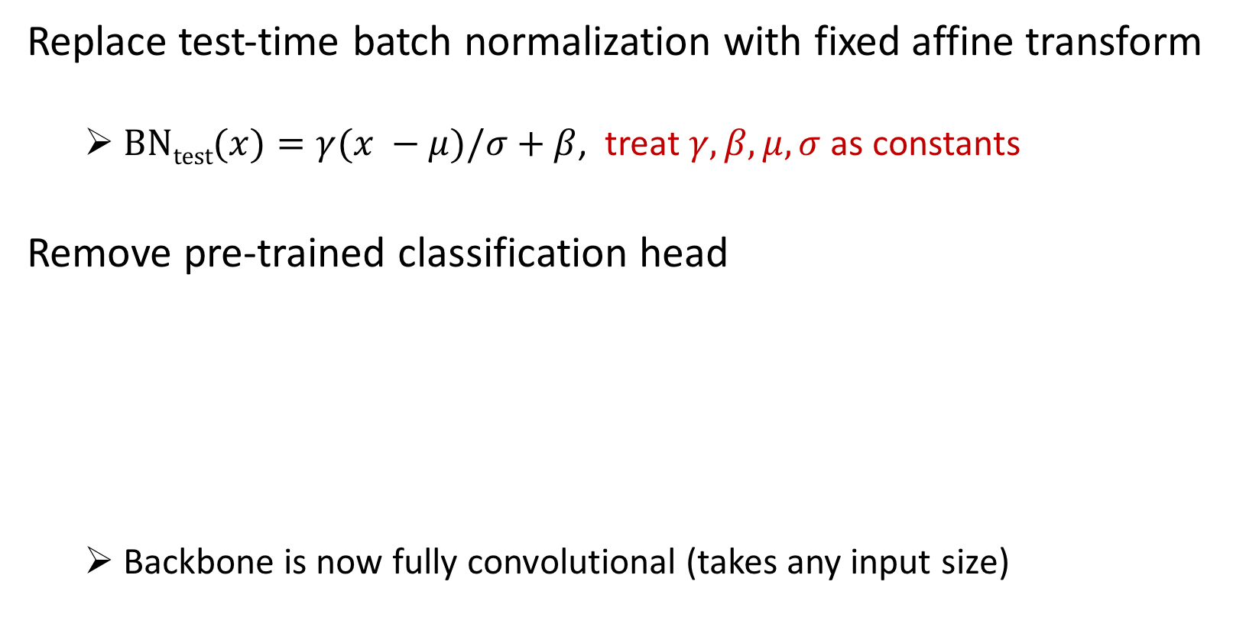
1. Prepare for Detection! (Minor Surgery)
Replace test-time batch normalization with fixed affine transform
$\text{BN}\text{test}(x)=γ(x −μ)/σ+β$, treat $γ, β, μ,σ$ as constants
Remove pre-trained classification head
Backbone is now fully convolutional (takes any input size)

Slide 18
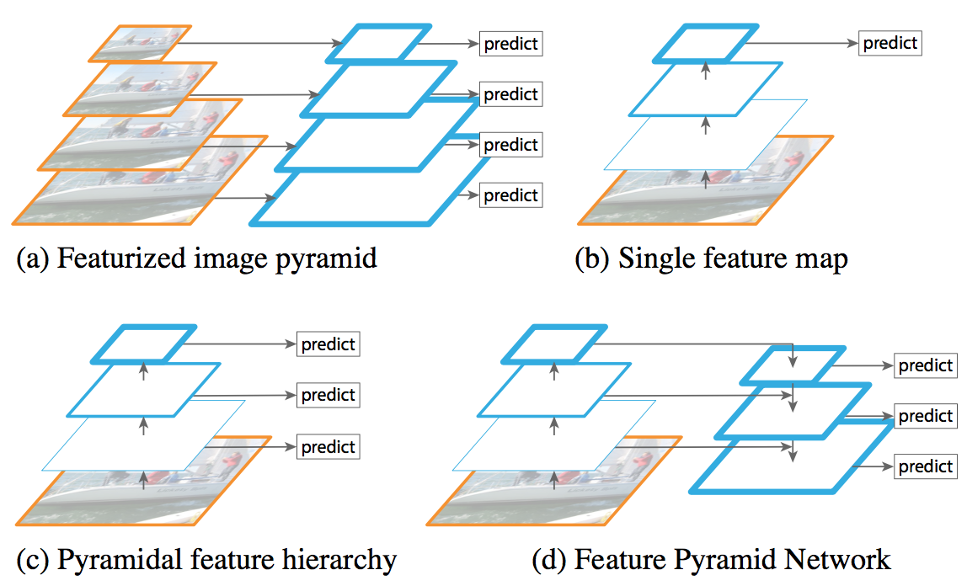
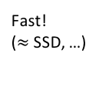
2. Scale Invariant Detection
SLOW!
(Viola & Jones, HOG, DPM, multiscale Fast R-CNN, …)
Do nothing; give up; Fast
(Fast R-CNN, YOLO, …)
Popular strategies for detecting
objects over large scale changes
Fast!
($≈$SSD, …)

Slide 19
2. Scale Invariant Detection
SOW!!
(Viola & Jones, HOG, DPM, multiscale Fast R-CNN, …)
Do nothing; give up; Fast!
(Fast R-CNN, YOLO, …)
Let’s examine this one
Fast!
($≈$SSD, …)

Slide 20
Compromise Feature Quality, but Fast (“Free”)
Low resolution,
Strong features
conv5
conv4
High resolution,
Weak features
conv3
The “native” in-network feature pyramid
poses an inherent tradeoff

Slide 21
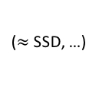
2. … + Feature Pyramid Network (FPN)
[Optional, but recommended]
(Viola & Jones, HOG, DPM, multiscale Fast R-CNN, …)
Do nothing; give up
(Fast R-CNN, YOLO, …)
($≈$SSD, …)
(Fast/er R-CNN with FPN, …)
Lin et al. Feature Pyramid Networks for Object Detection. In CVPR 2017. Poster 99 Saturday morning. See also: Shrivastava’s TDM

Slide 22
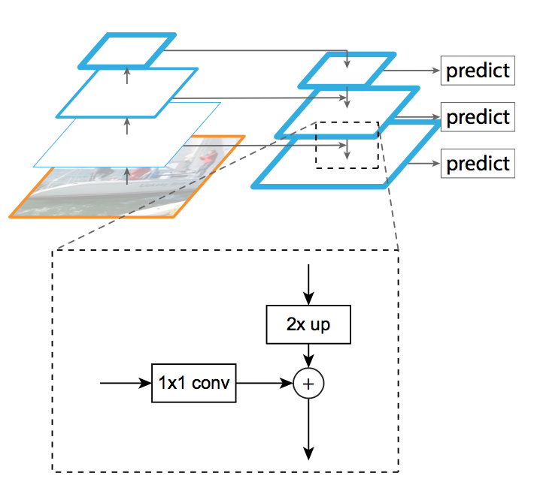
FPN
1/16 image resolution
Res4 stage output
1/8 image resolution
Res3 stage output
(Illustrated with
3 levels for simplicity;
typically use 5 or 6)
Backbone ConvNet
1/4 image resolution
Res2 stage output
FPN weights
use random
initialization
Input
Lin et al. Feature Pyramid Networks for Object Detection. In CVPR 2017. Poster 99 Saturday morning.

Slide 23
No Compromise on Feature Quality, still Fast
Low resolution,
Strong features
FPN pyramid
High resolution,
Strong features
Lin et al. Feature Pyramid Networks for Object Detection. In CVPR 2017. Poster 99 Saturday morning. See also: Shrivastava’s TDM

Slide 24
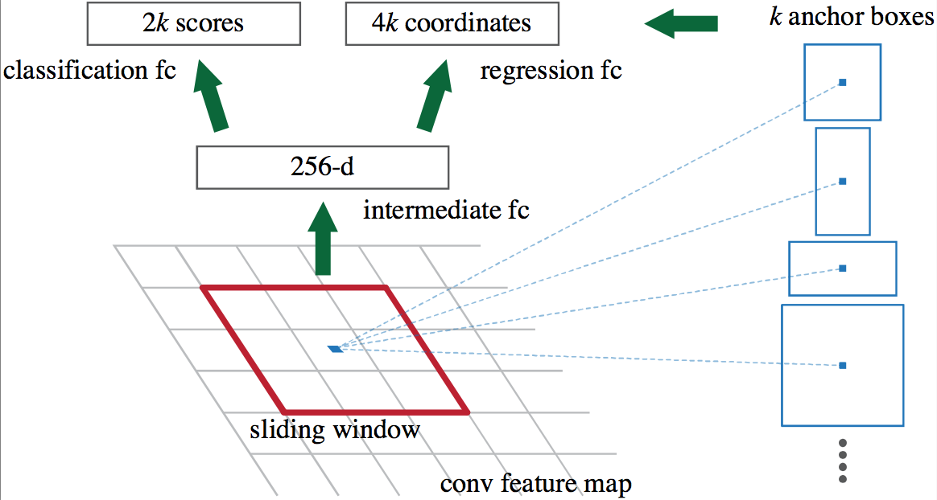
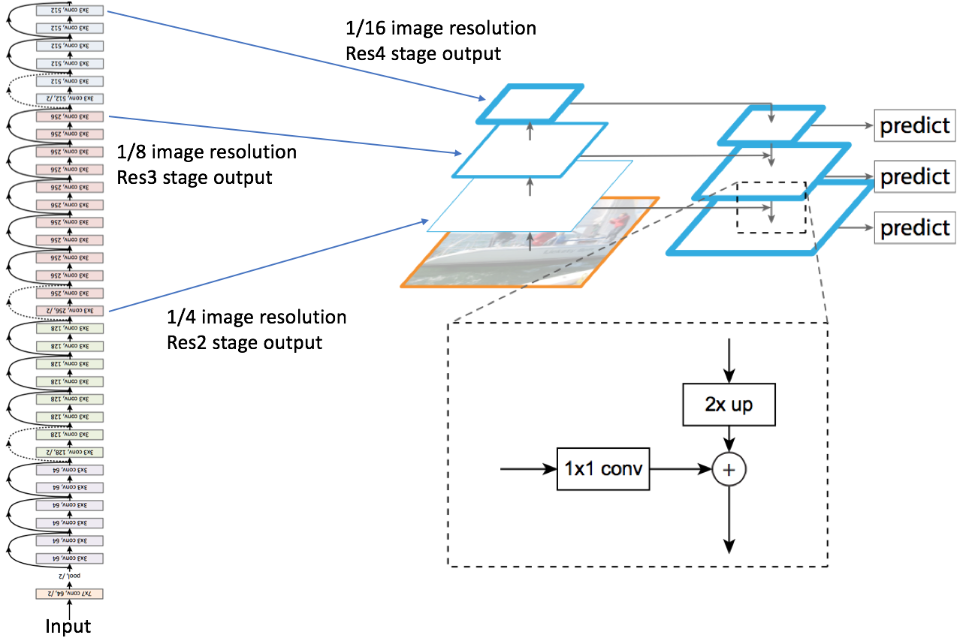
3. … + Region Proposal Network (RPN)
Proposals = sliding window object/not-object classifier + box regression
inside the same network
(Shared over
FPN levels)
Anchors are prototypical object boxes
256-d
Applied on each FPN level
FPN
Ren et al. Faster R-CNN: Region Proposal Networks for Real-Time Object Detection. In NIPS 2015

Slide 25
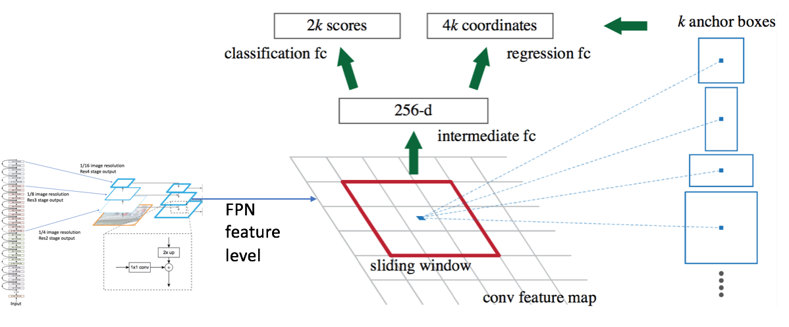
4. … + RoIAlign Transform (on each Proposal)
Smoothly normalize features and predictions into coordinate frame
free of scale and aspect ratio
256-d
FPN feature level
(Fixed dimensional
representation)
256-d
Grid of bilinear
interpolation points
RoIAlign
transform
Proposal
from RPN
Feature value
is average of
interpolated
values on grid
(Variable size RoI)

Slide 26
4. … + RoIAlign Transform (on each Proposal)
Key: No coordinate quantization (cf. RoIPool in Fast R-CNN, etc.)
256-d
FPN feature level
(Fixed dimensional
representation)
256-d
Grid of bilinear
interpolation points
RoIAlign
transform
Proposal
from RPN
Feature value
is average of
interpolated
values on grid
(Variable size RoI)

Slide 27
Compare to RoIPool, RoIWarp, and others
Quantization breaks pixel-to-pixel alignment
😖
256-d
256-d
Quantized RoI
Original RoI
RoIPool coordinate
quantization
😖

Slide 28
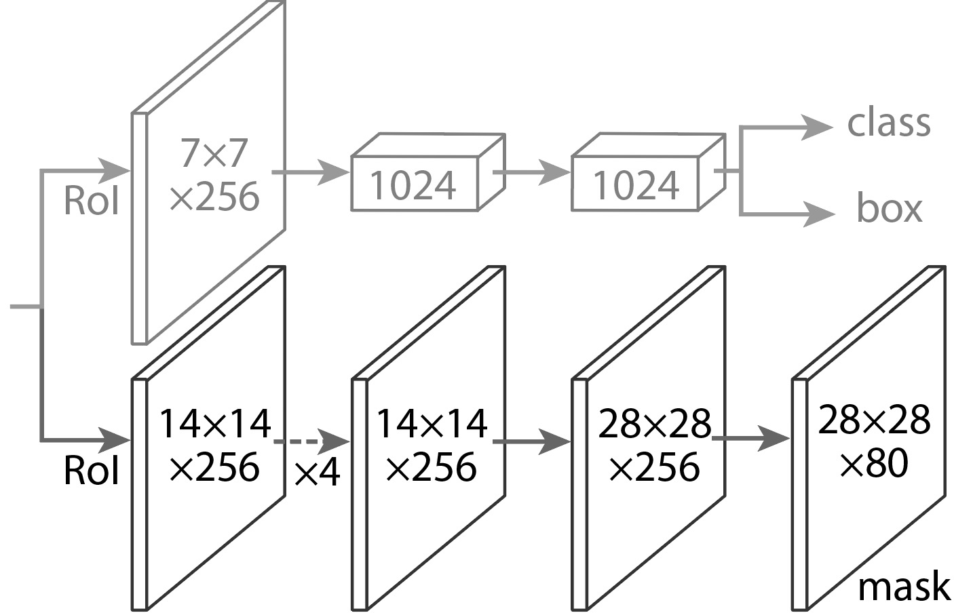
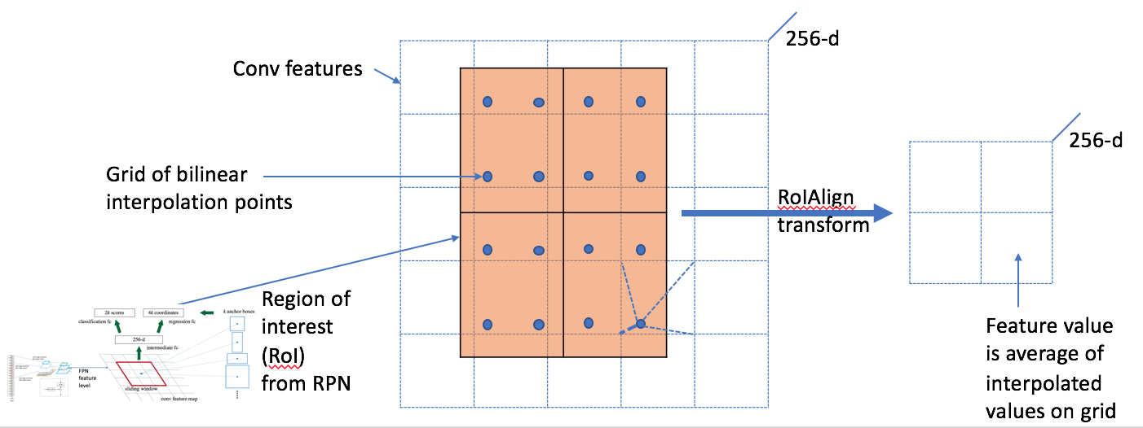
5. … + Task-specific Heads (on each Proposal)
Task specific heads for …
Bounding box detection
Object classification
Instance mask prediction
Human keypoint prediction
Standard FPN-based Fast/er R-CNN head
RoIAlign
transformed
features

Slide 29
5. … + Task-specific Heads (on each Proposal)
Task specific heads for …
Object classification
Bounding box regression
Instance mask prediction
Human keypoint prediction
Standard FPN-based Fast/er R-CNN head
Per-proposal FCN predicts instance masks
RoIAlign
transformed
features
Conv3x3 * 4
ConvTranspose
Conv1x1

Slide 30
Mask R-CNN: Training
Not enough time for details (sorry!)
Same as “image centric” Fast/er R-CNN training
Use precomputed proposals for faster experimentation
Use joint / end-to-end training for sharing features
But with training targets for masks

Slide 31
Example Mask Training Targets
Image with training proposal
28x28 mask target
Image with training proposal
28x28 mask target

Slide 32
Mask R-CNN: Inference
1. Perform Faster R-CNN inference
Generate proposals (RPN)
Score the proposals
Regress from proposals to refined detection boxes
Apply NMS and take the top K (= 100, e.g.)
2. Run RoIAlign and mask head on top-K refined, post-NMS boxes
Fast (only compute masks for top-K detections)
Improves accuracy (uses refined detection boxes, not proposals)

Slide 33
Mask Prediction
28x28 soft prediction from Mask R-CNN
(enlarged)
Soft prediction resampled to image coordinates
(bilinear and bicubic interpolation work equally well)
Final prediction (threshold at 0.5)
Validation image with box detection shown in red

Slide 34
Mask Prediction
28x28 soft prediction
Resized soft prediction
Final mask
Validation image with box detection shown in red

Slide 35
Mask Prediction
28x28 soft prediction
Resized Soft prediction
Final mask
Validation image with box detection shown in red

Slide 36
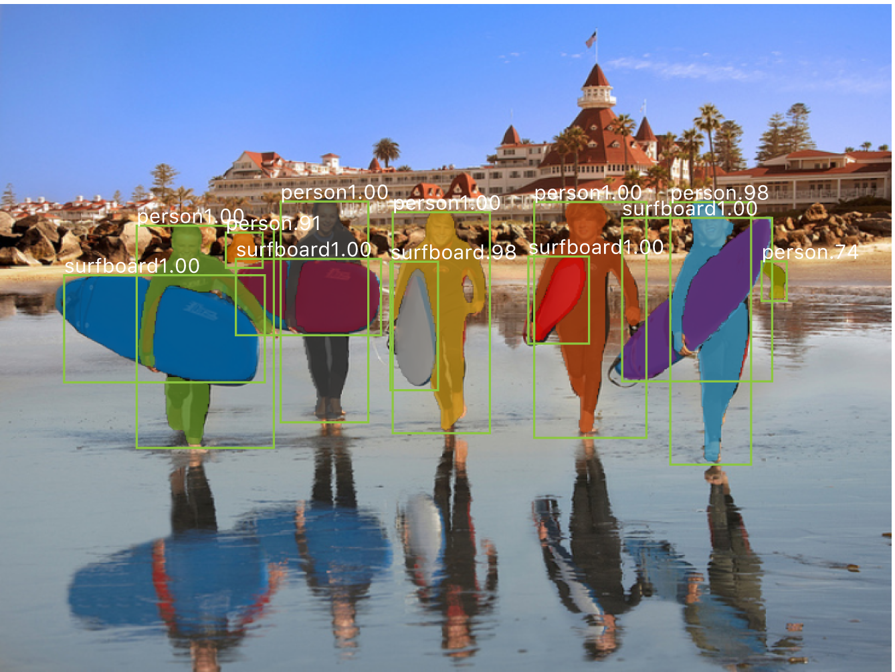

Slide 37
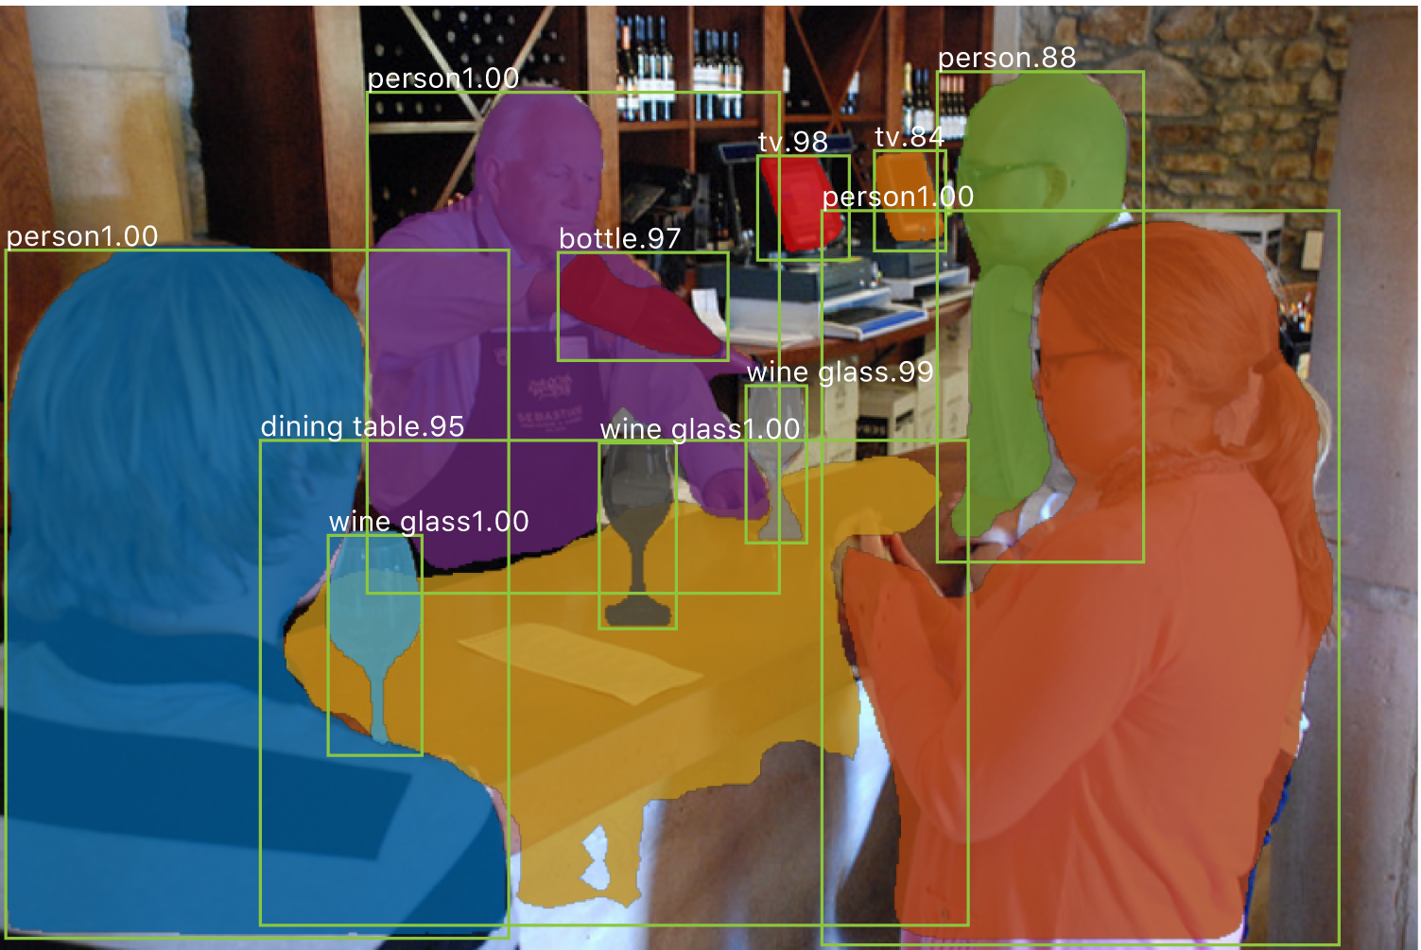

Slide 38
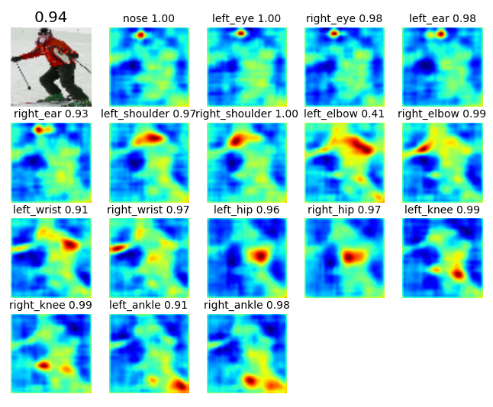
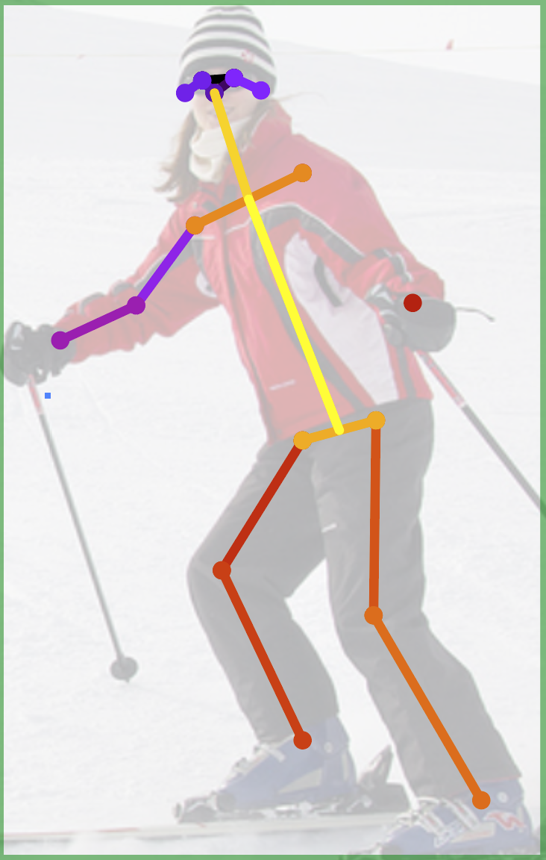
Human Pose
x17
(Not shown: Head architecture is slightly different for keypoints)
keypoints
17 keypoint “mask”
predictions shown as heatmaps with OKS scores from argmax positions
Add keypoint head (28x28x17)
Predict one “mask” for each keypoint
Softmax over spatial locations (encodes one keypoint per mask “prior”)

Slide 39
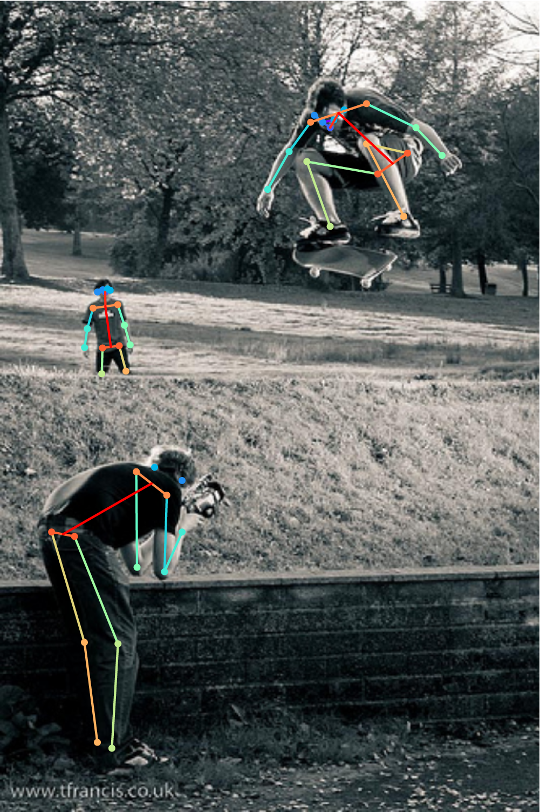

Slide 40
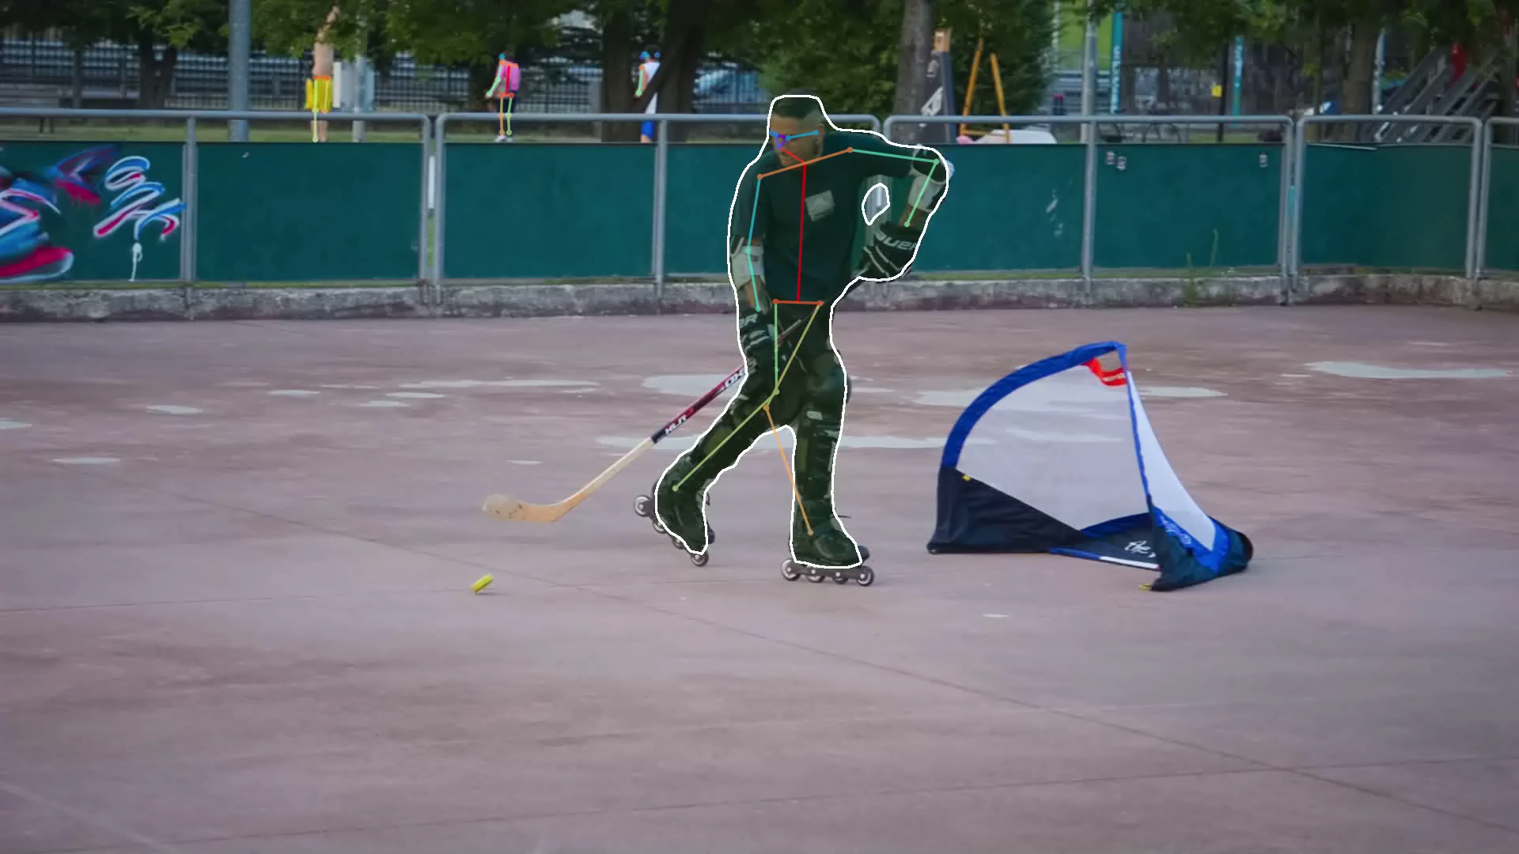

Slide 41
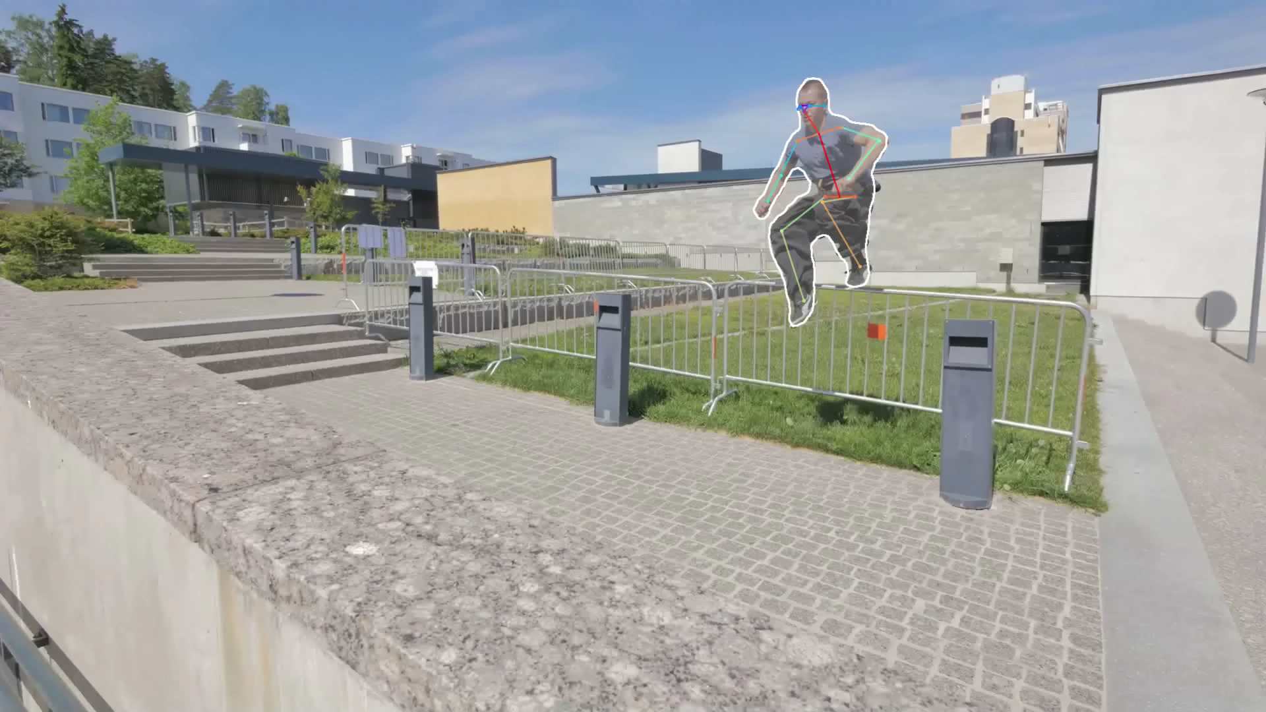

Slide 42
Deep Learning for Object Detection: A Bewildering Word Salad
R-CNN OverFeat DetectorNet DeepMultibox SPP-net Fast R-CNN MR-CNN SSD YOLO YOLOv2 G-CNN AttractioNet Mask R-CNN R-FCN RPN FPN Faster R-CNN …
and many more words

Slide 43
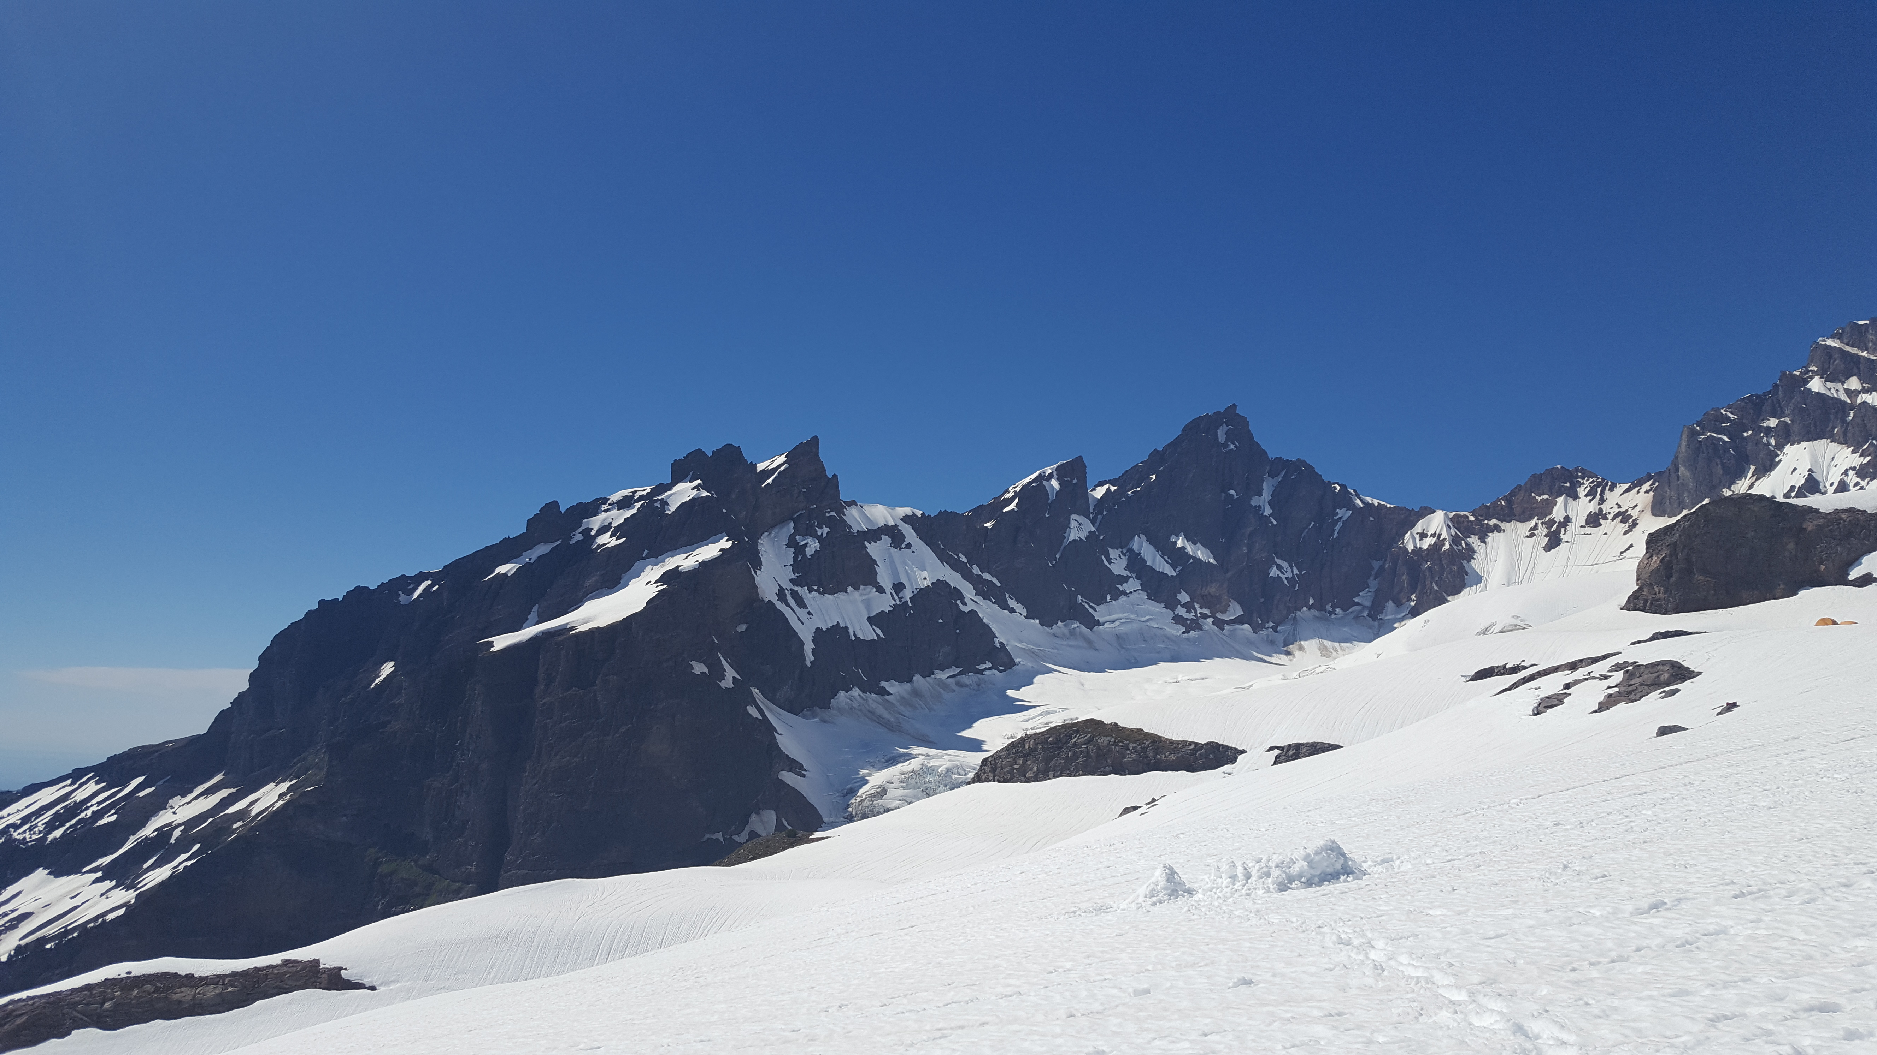
Let’s Organize the Landscape
Mask R-CNN
Faster R-CNN
SSD
R-CNN
YOLO
A random landscape scene on Mt. Baker, just because I like mountains. Photo credit: Ross Girshick

Slide 44
Common to all Methods
Start by modifying a classification network
Since R-CNN, this network is pre-trained, typically using ImageNet (cf. DetectorNet)
R-CNN: Girshick et al. Rich Feature Hierarchies for Accurate Object Detection and Semantic Segmentation. CVPR 2014
DetectorNet: Szegedy et al. Deep Neural Networks for Object Detection. NIPS 2013

Slide 45
Highest Information Gain Split: “Stage” Count
More than one stage
DetectorNet (Szegedy et al.)
R-CNN (Girshick et al.)
SPP-net (He et al.)
Fast R-CNN (Girshick)
Faster R-CNN (Ren et al.)
R-FCN (Dai et al.)
Mask R-CNN (He et al.)
One stage
OverFeat (Sermanet et al.)
YOLO, YOLOv2 (Redmon et al.)
SSD (Wei et al.)
RetinaNet (Lin et al.) [Poster at WICV on Wed.]

Slide 46
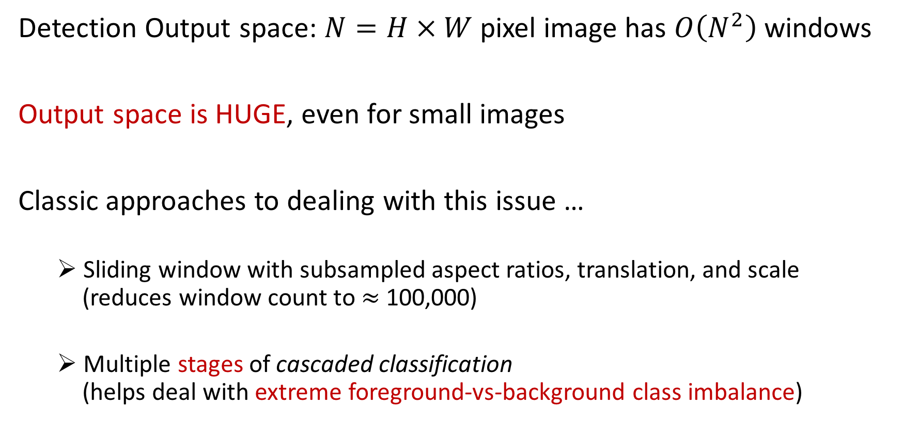
Stages
Detection Output space: $N=H × W$ pixel image has $O\left(N^{2}\right)$ windows
Output space is HUGE, even for small images
Classic approaches to dealing with this issue …
Sliding window with subsampled aspect ratios, translation, and scale (reduces window count to $≈$ 100,000)
Multiple stages of cascaded classification (helps deal with extreme foreground-vs-background class imbalance)

Slide 47
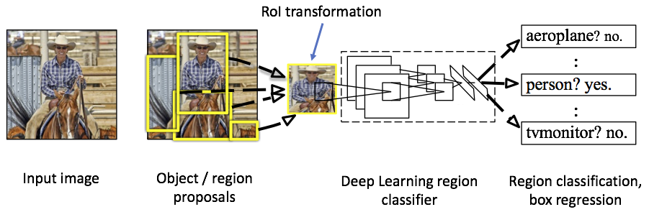
More than one “stage” ($≈$ proposal based; but doesn’t require proposals)

Slide 48
More than one “stage” ($≈$ proposal based; but doesn’t require proposals)
Cascade-like
reduction in
output space

Slide 49
More than one “stage” ($≈$ proposal based; but doesn’t require proposals)
Classification of
reduced output
space elements
Cascade-like
reduction in
output space

Slide 50
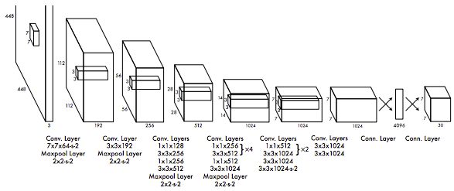
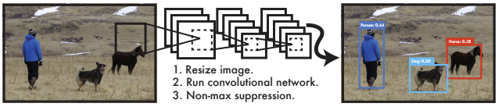
More than one “stage” ($≈$ proposal based; but doesn’t require proposals)
Classification of
reduced output
space elements
Cascade-like
reduction in
output space
One stage
Redmond et al. You Only Look Once:
Unified Real-time Object Detection. In CVPR 2016

Slide 51
More than one “stage” ($≈$ proposal based; but doesn’t require proposals)
Classification of
reduced output
space elements
Cascade-like
reduction in
output space
One stage
Direct classification
of all output space elements
“You only look once”
“Single shot”
Redmond et al. You Only Look Once:
Unified Real-time Object Detection. In CVPR 2016

Slide 52
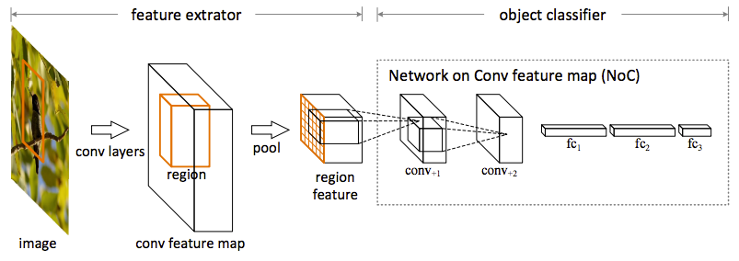
Thinking about Multi-stage Detectors
Image-wise computation
Region-wise computation
Ren et al. Object Detection Networks on Convolutional Feature Maps. PAMI 2017.

Slide 53
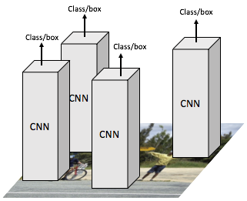
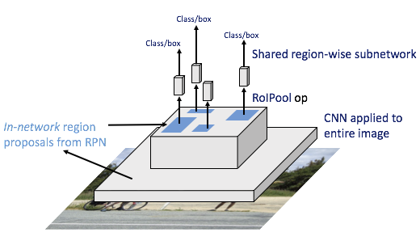
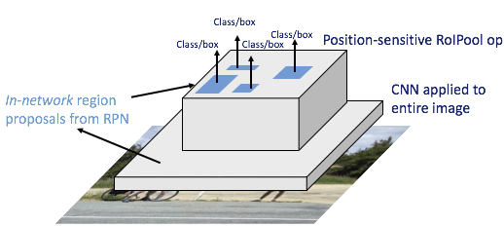
Networks on Convolutional Feature Maps
Shifting computation between the “head” and the “trunk”
R-CNN
Fast/er R-CNN
R-FCN
Head
Head
Head
(no FPN)
(with FPN)
Heavy region-wise head
Light region-wise head

Slide 54
Speed / Accuracy Tradeoffs
Speed is mainly a function of:
Input image resolution
Network complexity
Number of proposals (if applicable)
Optimizing AP on PASCAL VOC has lead to confusion about speed / accuracy tradeoffs
COCO provides a clear picture of tradeoffs

Slide 55
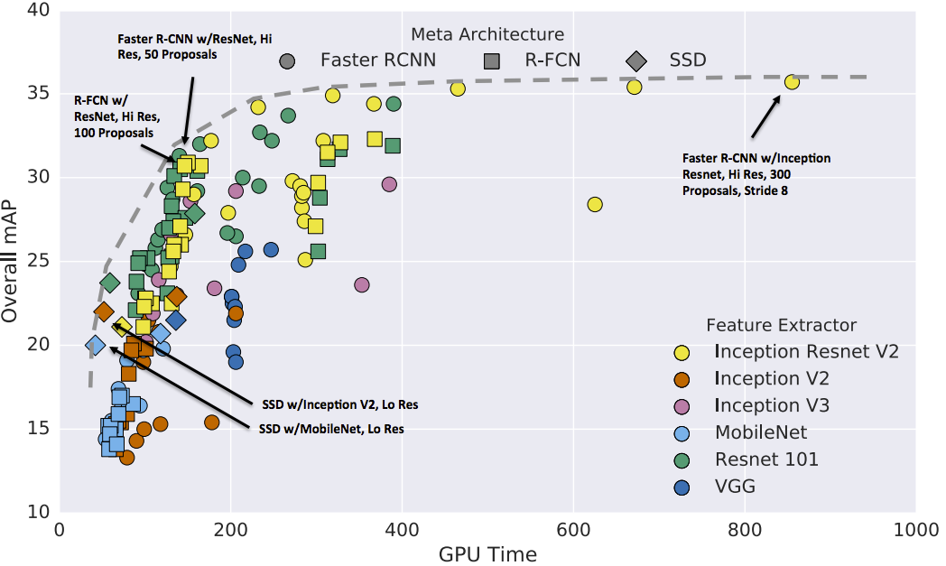
YOLOv2
(different impl.; not 100% comparable)
Huang et al. Speed/Accuracy Tradeoffs for Modern Convolutional Object Detectors. CVPR 2017

Slide 56
Past vs. Present
101 layers
2015
How did we
get here?
2014
2013
2012
Already a 2x AP improvement!
2007
16 layers
8 layers
shallow
shallow
*w/ other improvements & more data
Slide credit: Kaiming He
Kaiming He, Xiangyu Zhang, Shaoqing Ren, & Jian Sun. “Deep Residual Learning for Image Recognition”. CVPR 2016.

Slide 57
False in 2012 and earlier, but True since 2013
State-of-the-art detectors
Improve with more data
Improve with increased model capacity
Improve from transfer learning
Immediately benefit from image classification research
Share a common modeling framework with speech and NLP

Slide 58
Conclusions. Thank you! Questions?
Object detection has come a very long way in a short time!
We’re moving from box detection to instance-level understanding
Major challenges remain:
Long-tailed examples-per-category distribution (implies low-shot learning)
Open vocabulary recognition (implies benchmarking challenges)
Low accuracy with very heavy occlusion / clutter (esp. for keypoints; “reasoning”)
Bottleneck may still be the raw engine of recognition (improve backbone, data)

Slide 59
Class/box
Class/box
Class/box
CNN
Class/box
CNN
CNN
CNN

Slide 60
Class/box
Class/box
Class/box
Shared region-wise subnetwork
RoIPool op
CNN applied to entire image
In-network region proposals from RPN

Slide 61
Class/box
Class/box
Position-sensitive RoIPool op
Class/box
Class/box
CNN applied to entire image
In-network region proposals from RPN

